Slide 1
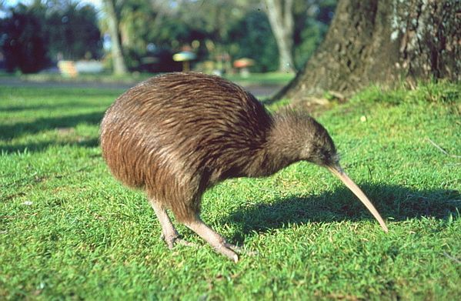
App Trader
Presentation
Kiwi team:
Media
Diego
Lori
Ari
We make a living from digging out data.
-Team Kiwi

Slide 2
Deliverables
Top 10 Apps to BUY NOW for Memorial Day debut
Recommendations on what apps to target, based on:
Price range
Genre
Content Rating

Slide 3
What we focused on
Bottom line - this is a business…. BUSINESS metrics drive decisions!
Focused on
Profit
Return on Investment (ROI)
Other data points as tie breakers

Slide 4

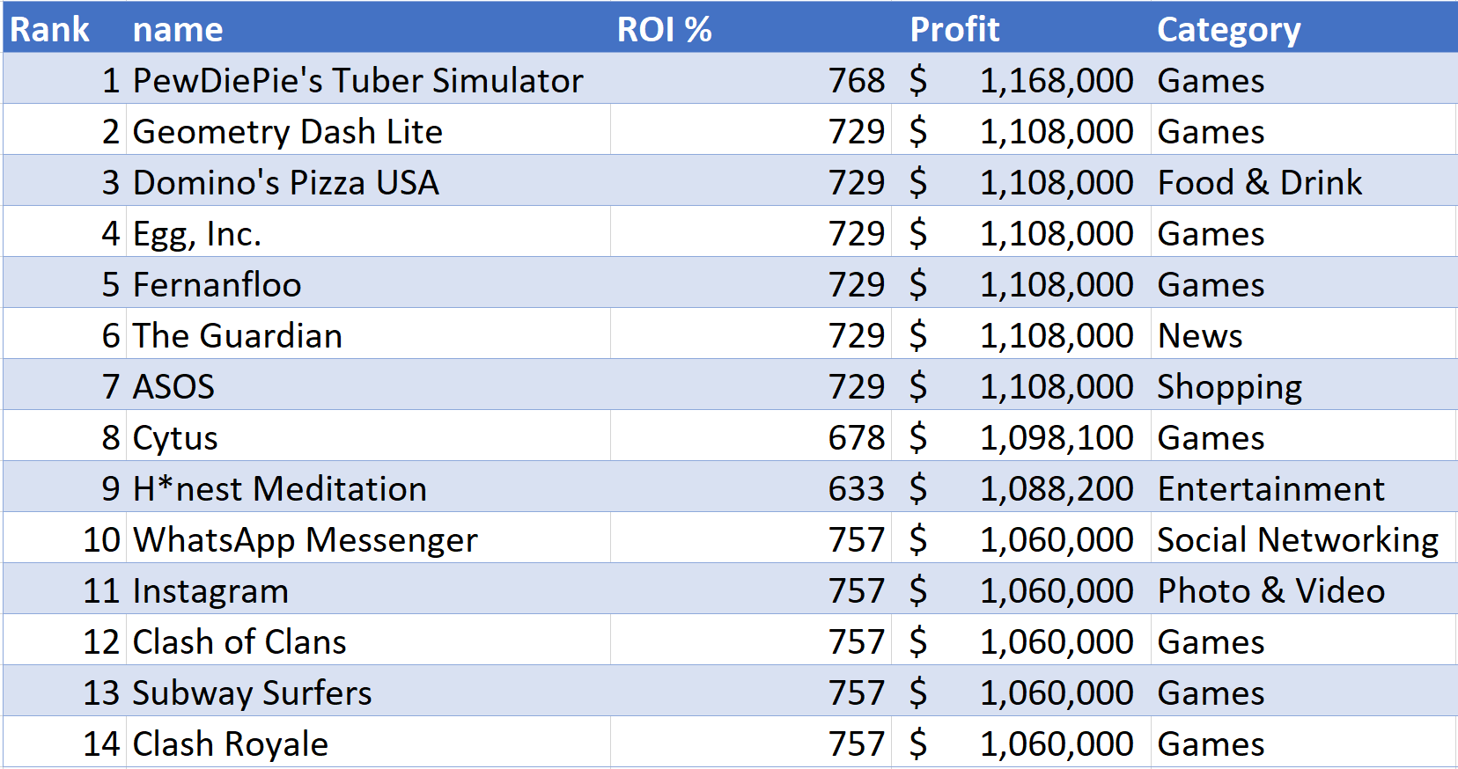
Domino’s Pizza, The Guardian, WhatsApp, Instagram probably not attainable

Slide 5

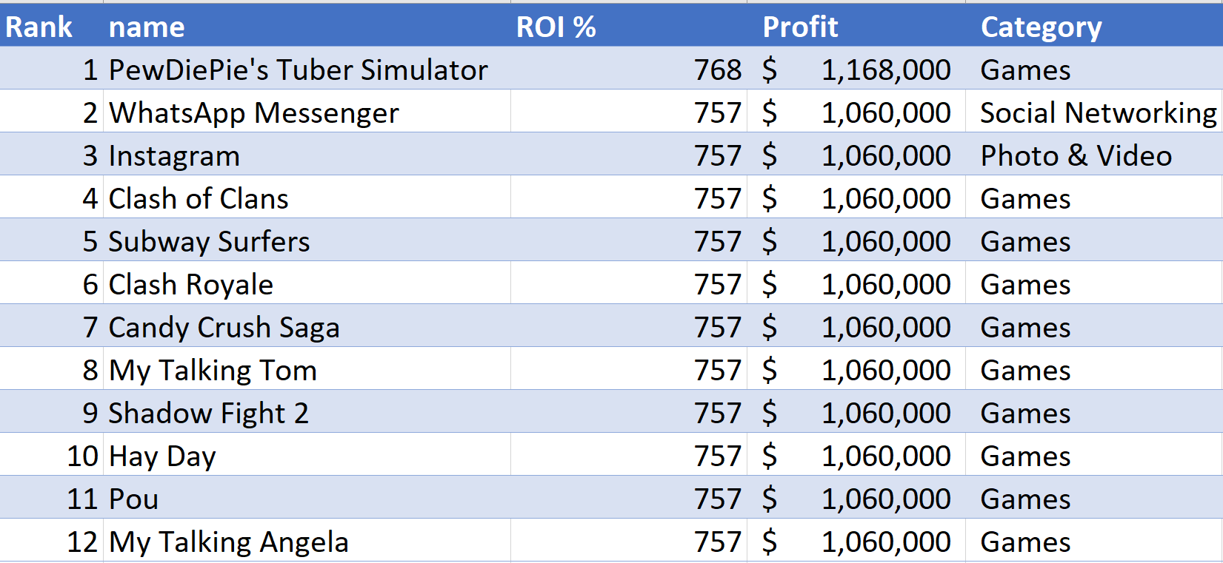
Alternate: Top 10 by ROI
WhatsApp and Instagram owned by Facebook - likely not attainnable

Slide 6
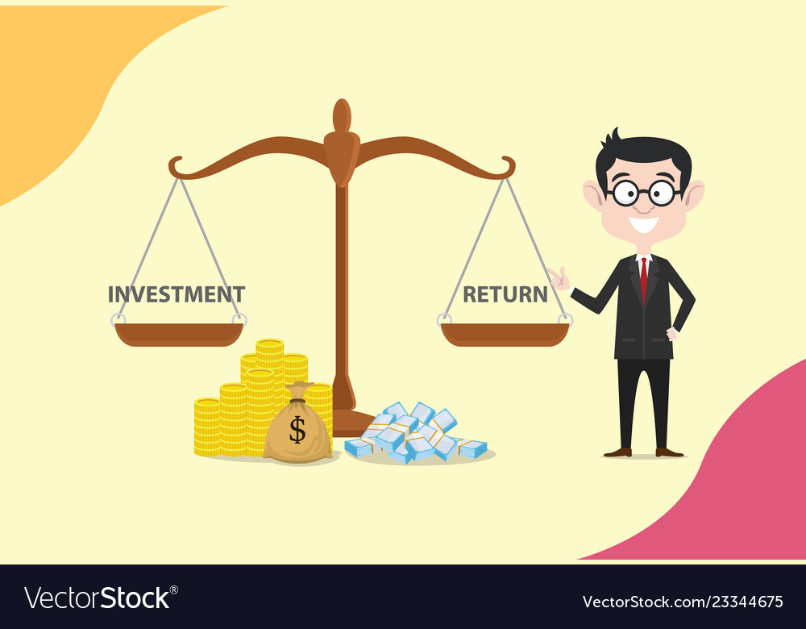
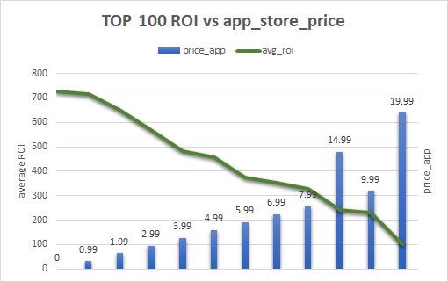
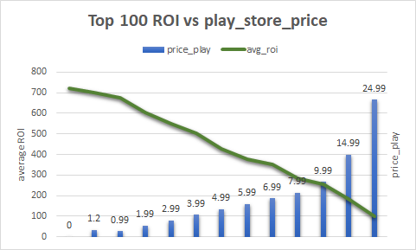
Price Range
0-24.99 is the price range from both stores among the top 100 ROI
Top ROI comes from low range prices
TOP

Slide 7
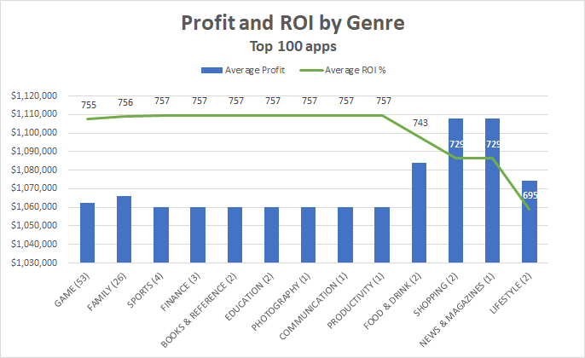
Genre
Best ROI + Size of Opportunity

Slide 8
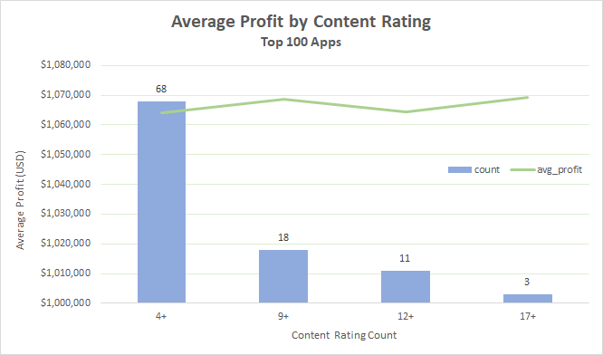
Content Rating
Notes:
This chart displays the count of content rating (in blue bar) of top 100 apps and their average profit (green line)
Which shows no difference in average profit.
But overall have more profit in apps with the content rating of 4+.

Slide 9
Final Recommendations
PRICE RANGE: BEST ROI
The lowest price + high reviews from top 100 ROI
GENRE: Best ROI, and $1M Average Net Profit
Games: 53 apps
Family: 26 apps
CONTENT RATING
No significant difference in the average profit
Majority apps are in the 4+ content rating

Slide 10

Questions?

